Slide 1
Job Classification
Junior
Senior
Manager
An outlook of the Data Scientist Job Market in the U.S.
Capstone Project
General Assembly
Anshu

Slide 2
Dataset to explore
Data Source: https://www.dataworld.com/
Information: Position, Company, Location, Job Description, and Category, job board
Exploring questions:
Which company hires the most Data Science job?
From the data, which cities and state hire the most?
What is the is the most common job to appear when searching for 'Data Science'?
Downloaded dataset of 10000 data scientist positions
Based in USA.

Slide 3
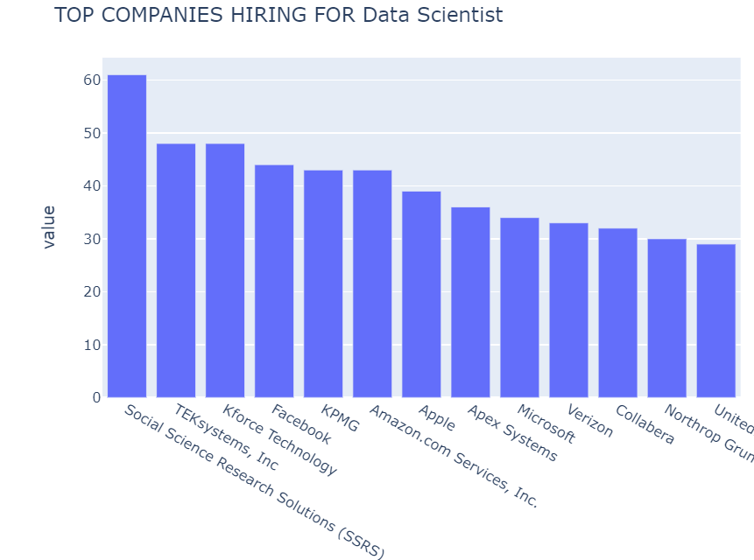
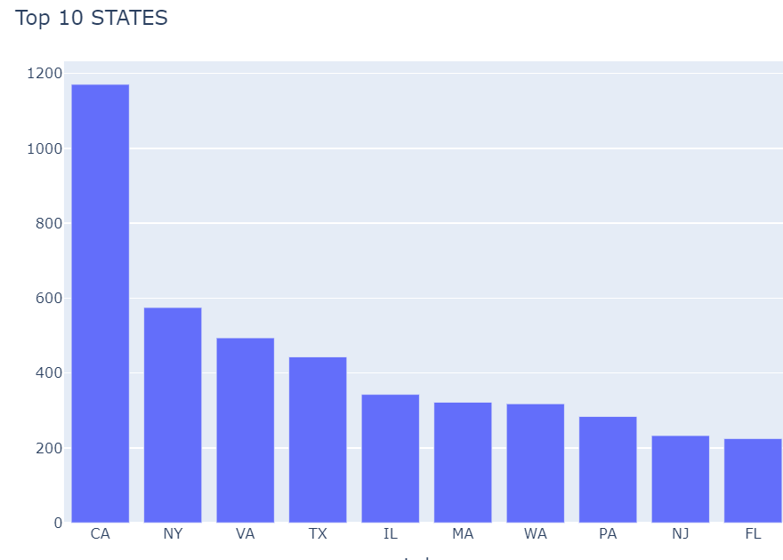
Number of Data Scientist Jobs in 2019

Slide 4
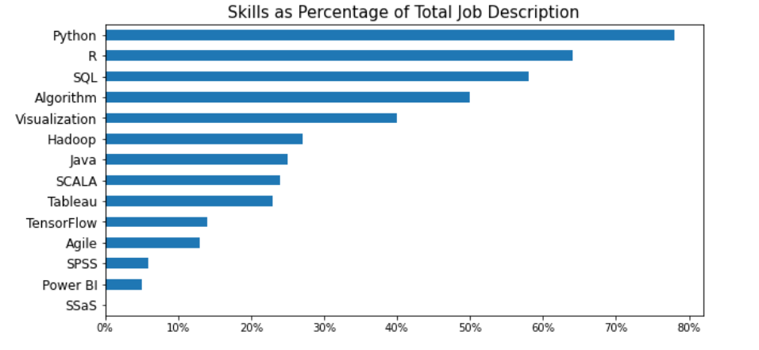
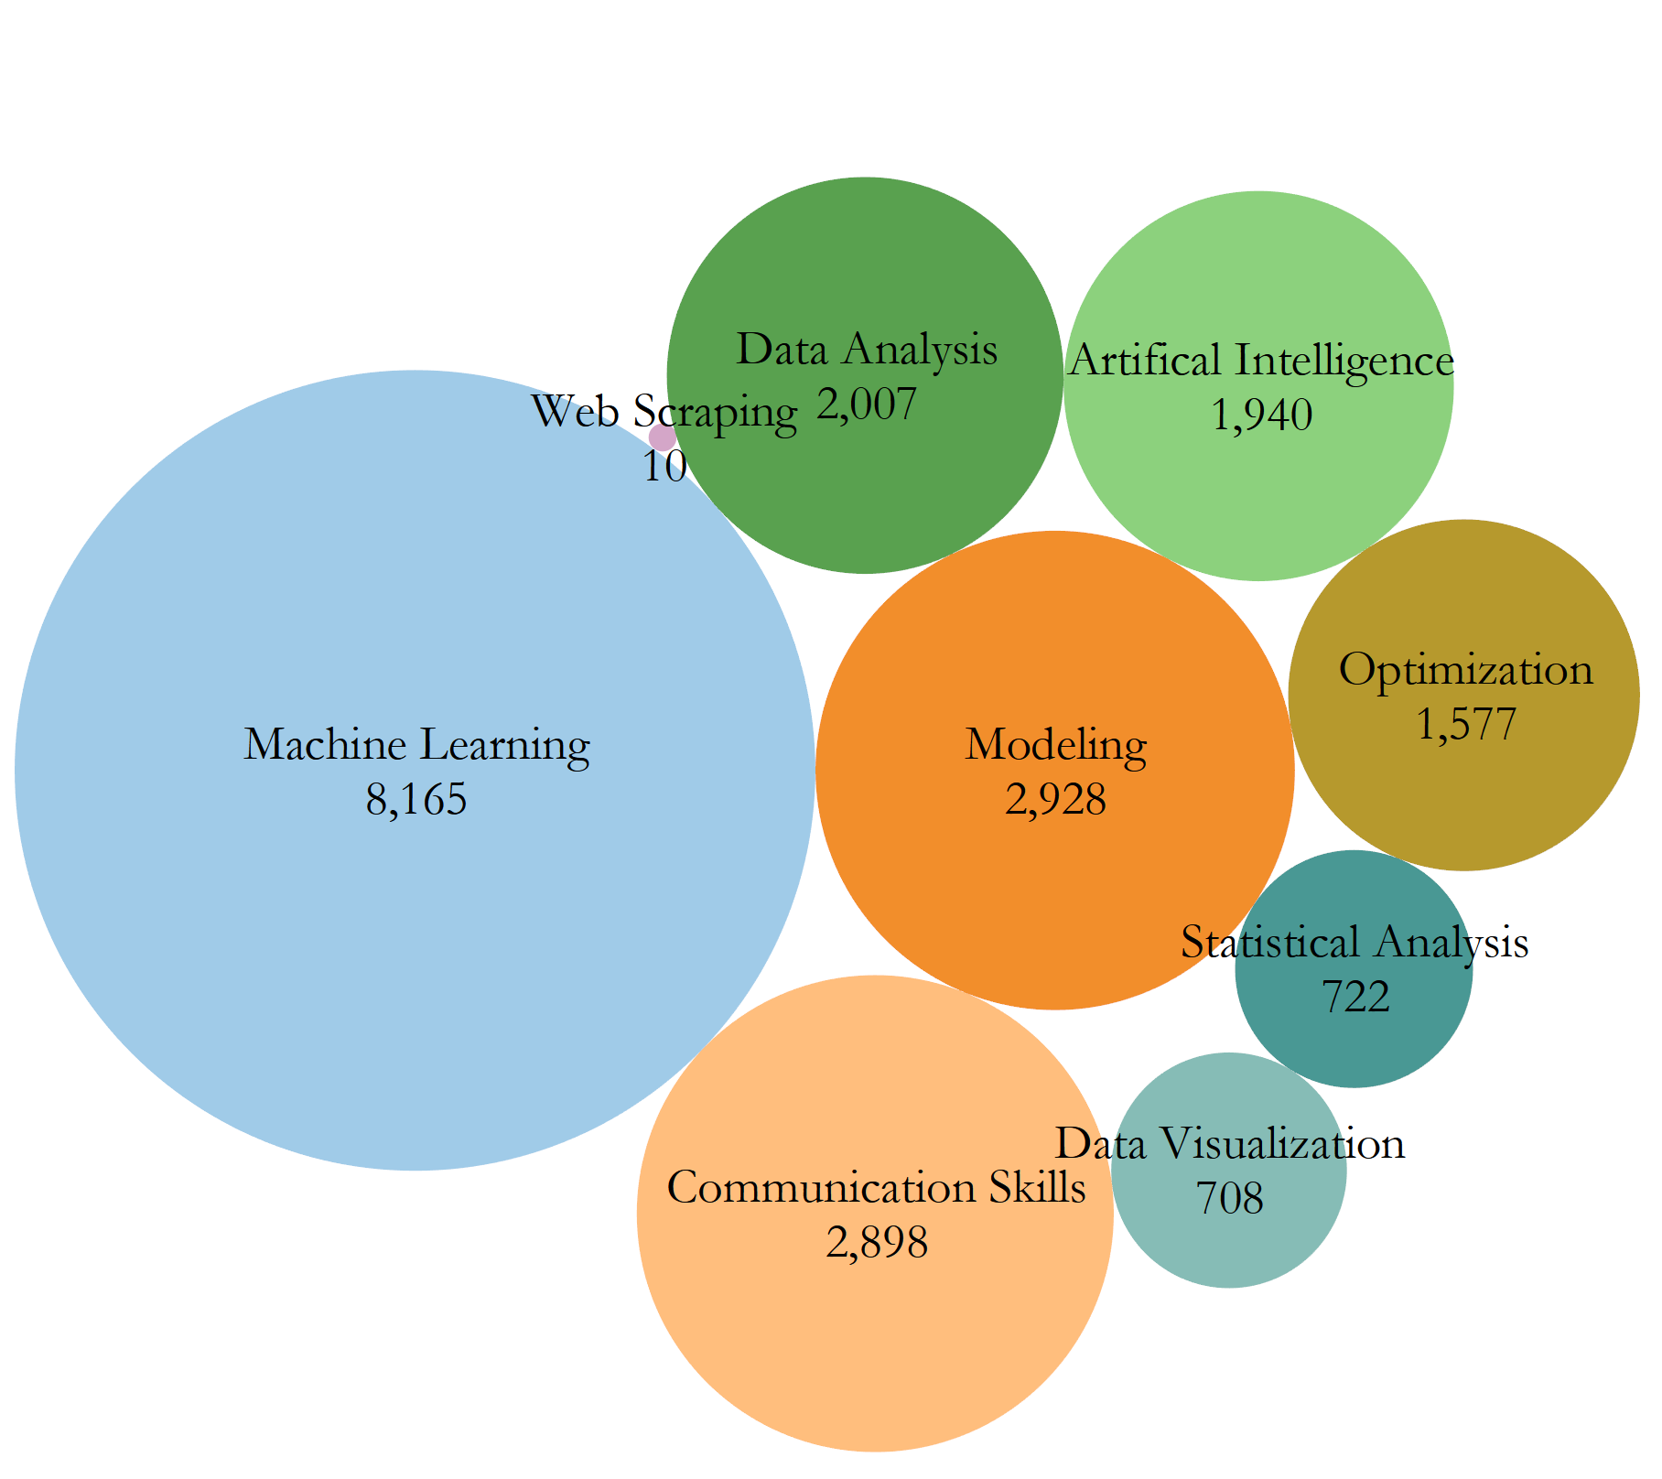
What tools and skills are desired the most?

Slide 5
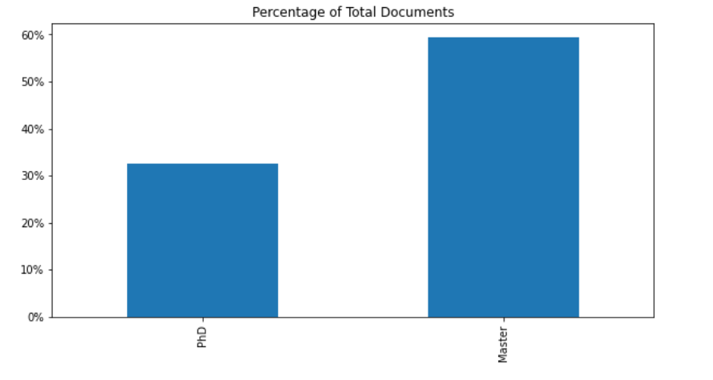
Does the degree matter?
More than 50% required master's degree.
30% required Phd

Slide 6
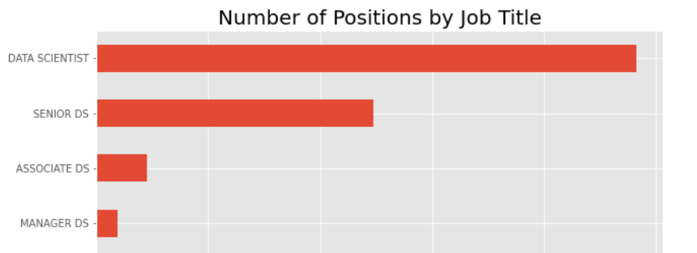
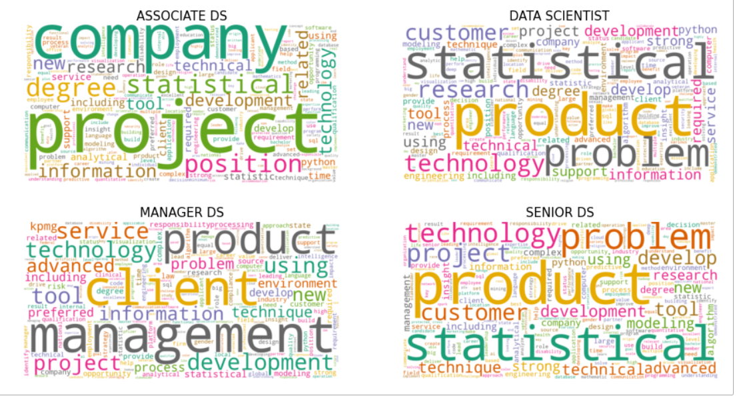
Multi Class Classification

Slide 7
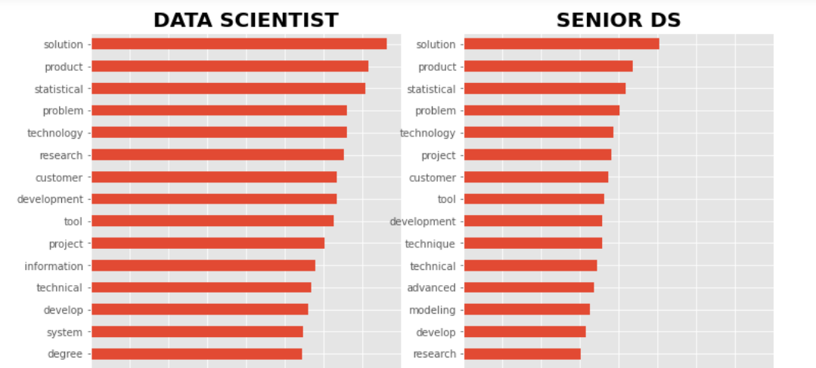
Data Scientist and Senior Design DS top words

Slide 8
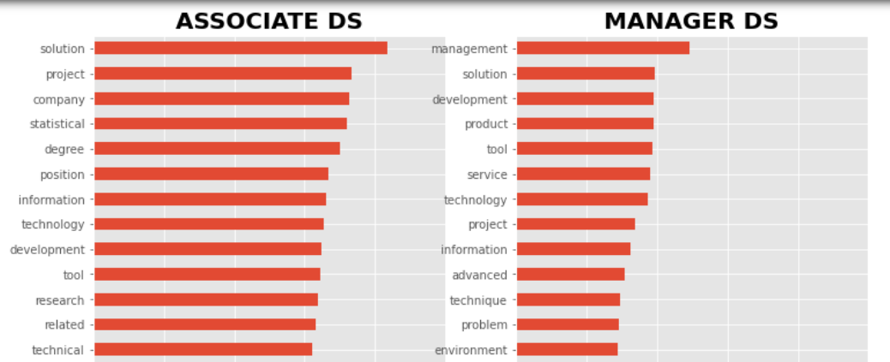

Associate and Manager DS top words

Slide 9
Model Prediction
Model | Training results | Testing results | Accuracy | Precision | Recall
Logistic Regression with Count Vectorizer | 0.99 | 0.82 | 0.82 | 0.79 | 0.74
Naïve Bayes with Count Vectorizer | 0.74 | 0.69 | 0.55 | 0.59 | 0..56
Random Forest with CountVectorizer | 0.95 | 0.82 | 0.82 | 0.82 | 0.69
XGBOOST with CV

Slide 10
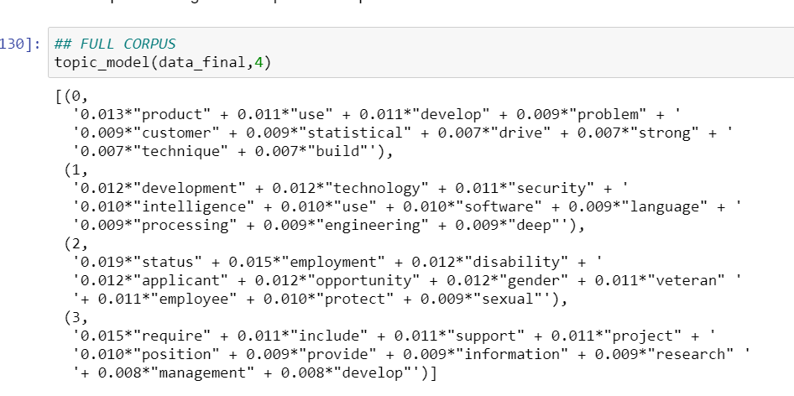
Can we use Topic Modeling to classify in different class?
Problem:
Cleaning of text data
Too many variables for an unsupervised machine learning clustering.
Results:
- Difficult to pick the right topics
Possible Reasons:
JD’s are not written well.
Employers don’t know what type of people they want.

Slide 11
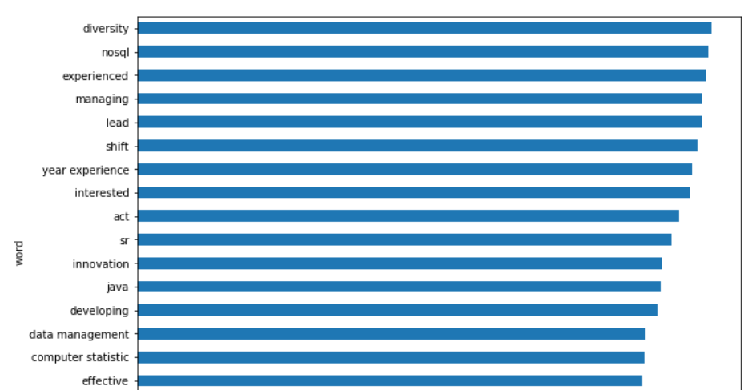
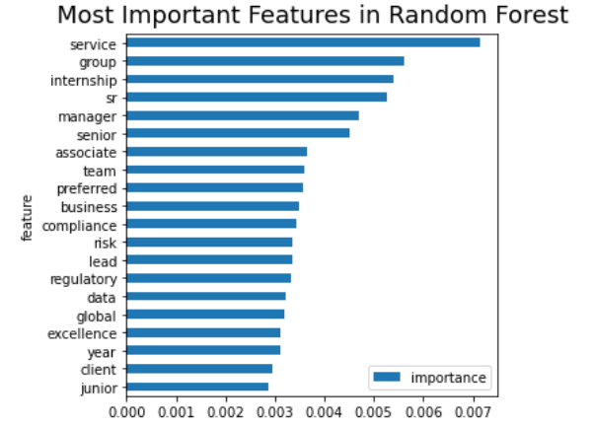

Top predictor features
Most Important Feature in Logistic
Most Important Feature in Random Forest

Slide 12
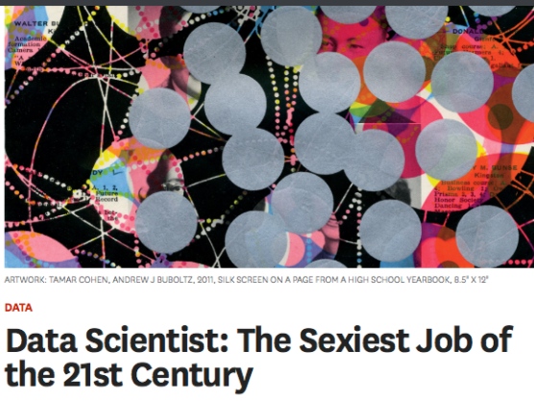
Conclusions &Recommendation
Who gets hired:
Excel, Python, R, SQL,
Machine Learning, Data/Statistical Analysis, Data Visualization.
Master’s degree (or higher degree)
Do employers know who they want to hire?
Not really : (
Read job descriptions carefully.

